Slide 1
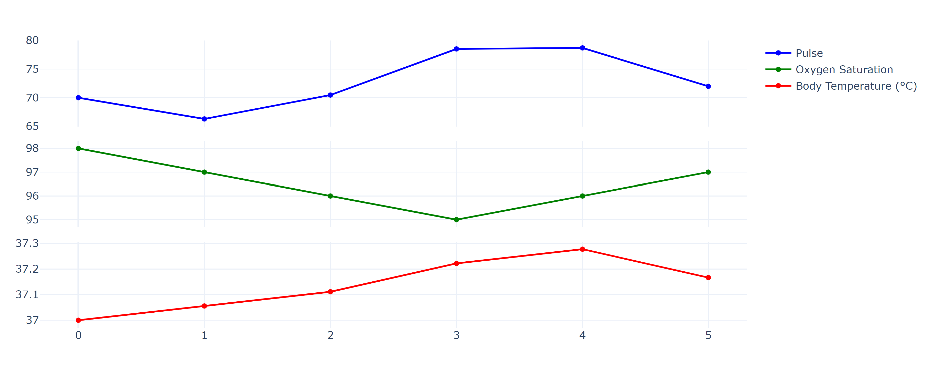


Multi parameter Health Monitoring System
Submitted
To
Prof. Dr. Hayek Ali
By
---
Saikot Das Joy

Slide 2
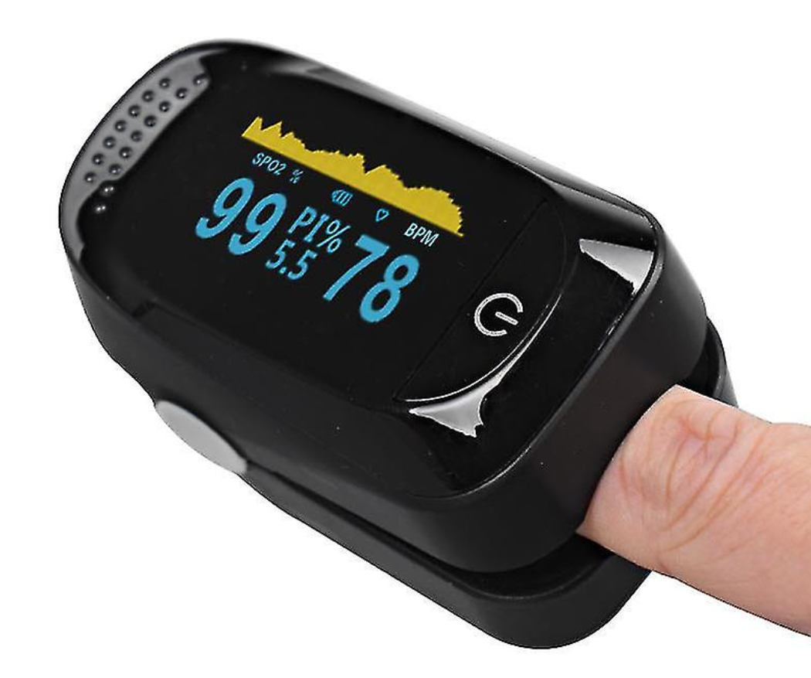
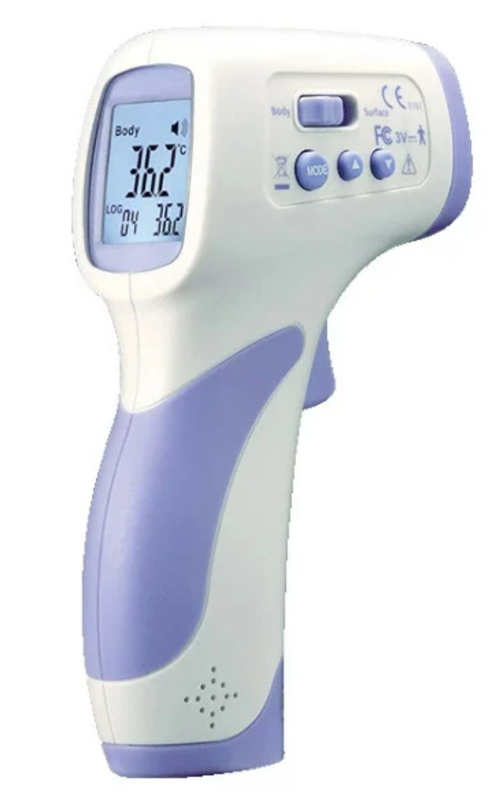

Motivation
Pulse Oximeter
Infrared Thermometer
(1) https://monitoring-shop.de/ir-fieberthermometer-dt-8806h-non-contact?keyword=&device=c&network=g&utm_term=&utm_campaign=monitoring-shop.de+Google+Shopping+DE+001&utm_source=adwords&utm_medium=ppc&hsa_acc=7594167586&hsa_cam=20252745755&hsa_grp=148399258725&hsa_ad=661214626073&hsa_src=g&hsa_tgt=pla-293946777986&hsa_kw=&hsa_mt=&hsa_net=adwords&hsa_ver=3&gclid=Cj0KCQjw_O2lBhCFARIsAB0E8B9nyrCJ3x9F4CUFM7oqeOV-_W2EjpDFIRRuaWSycaA6j4MRz_pMMhQaApb3EALw_wcB
(2) https://www.fruugo.de/finger-puls-oximeter-blut-sauerstoff-spo2-monitor/p-152730875-323164517?language=de&ac=ProductCasterAPI&asc=pmax&gclid=Cj0KCQjw_O2lBhCFARIsAB0E8B9Xe7ktCIbyy0l4olHjJYQDbGFZLAvMDfUyjbTSmSReKJYalyDRbcUaAhveEALw_wcB
(3) https://www.vectorstock.com/royalty-free-vector/covid19-19-patient-at-hospital-vector-30427277

Slide 3
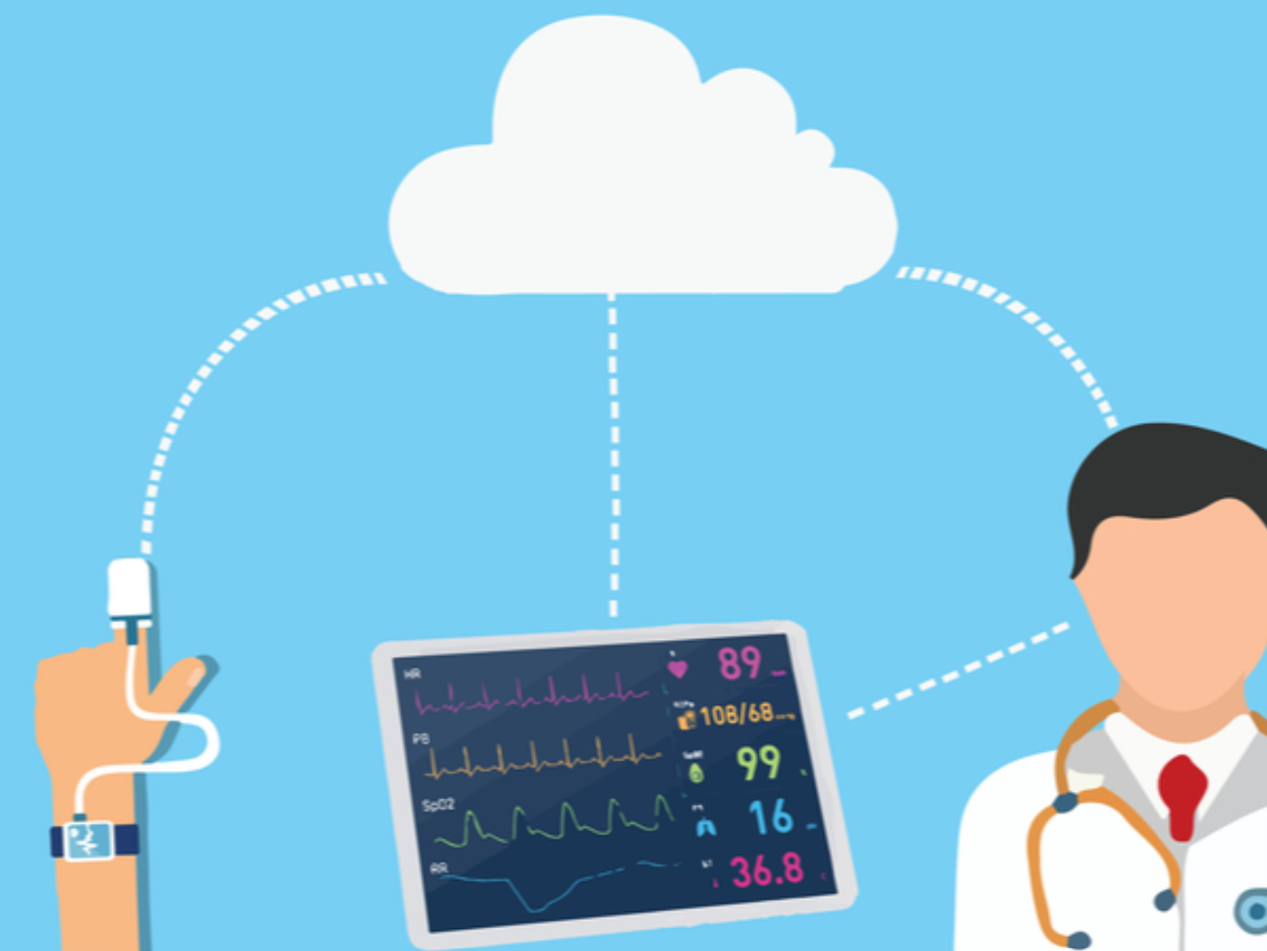
Objectives
Development of a Multiparameter Health Monitoring System
Real-time Measurement of Vital Parameters like Pulse, Oxygen Saturation , Temperature
Integration of Various Sensors and FPGA Board
Data visualization
Remote transmission of data
(1) https://www.freepik.com/free-vector/big-data-healthcare-personalized-medicine-patient-care-predictive-analytics-electronic-health-records-pharmaceutical-research_13450527.htm#query=patient%20monitoring&position=8&from_view=keyword&track=ais
(2) https://www.pharmatimes.com/web_exclusives/Remote_patient_monitoring_the_future_of_healthcare_1365643

Slide 4
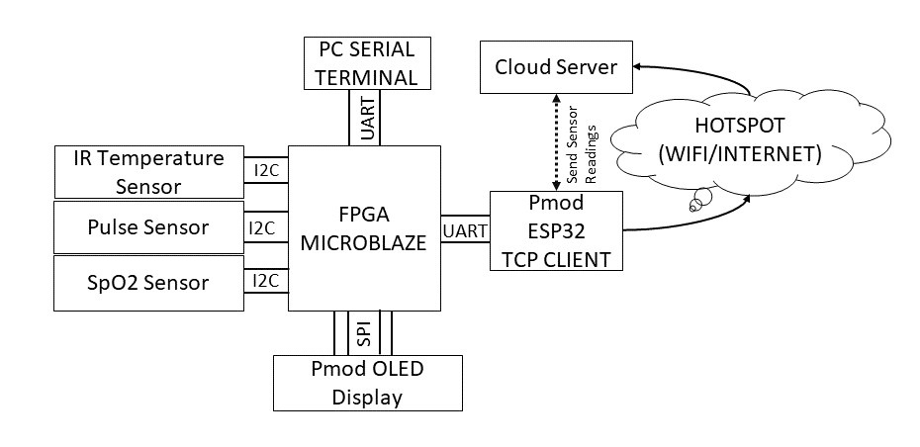
Project Overview

Slide 5
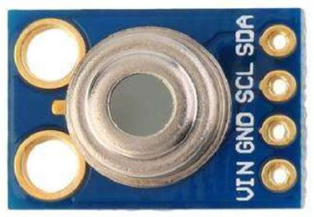
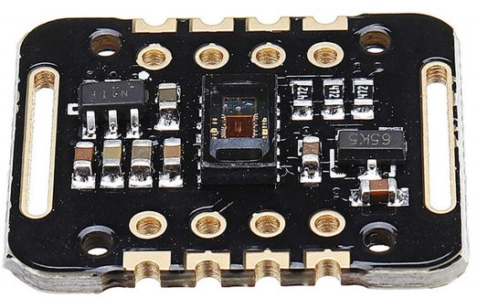
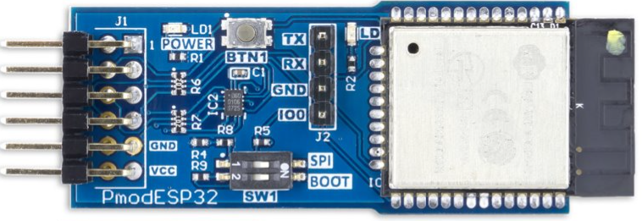
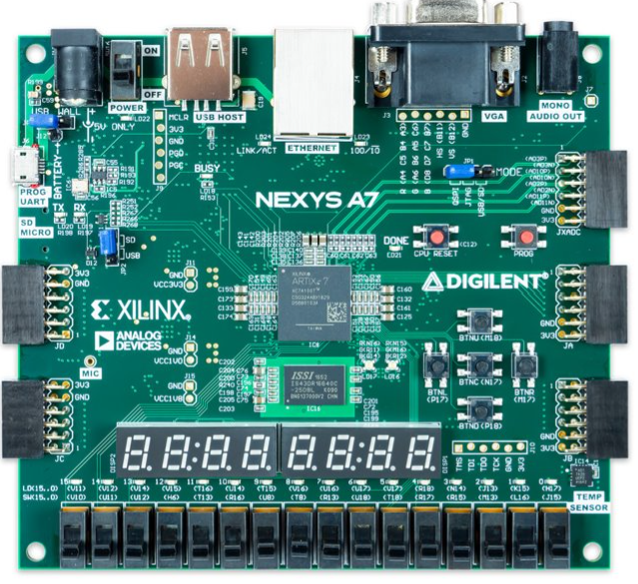
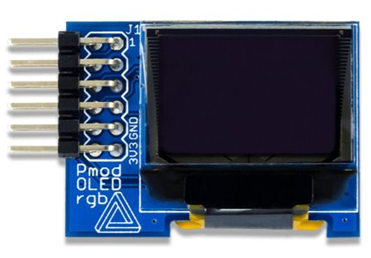
MLX90614 Infrared Temperature Sensor
Software Used
Hardware Used
Xilinx Vivado 2022.2
Xilinx Vitis 2022.2
MAX30102 Pulse Oximeter Sensor
Nexys A7-100T FPGA Board
Pmod ESP32 Module
Data Visualization
Thingspeak !!!!!!!!
Pmod OLEDrgb Display

Slide 6
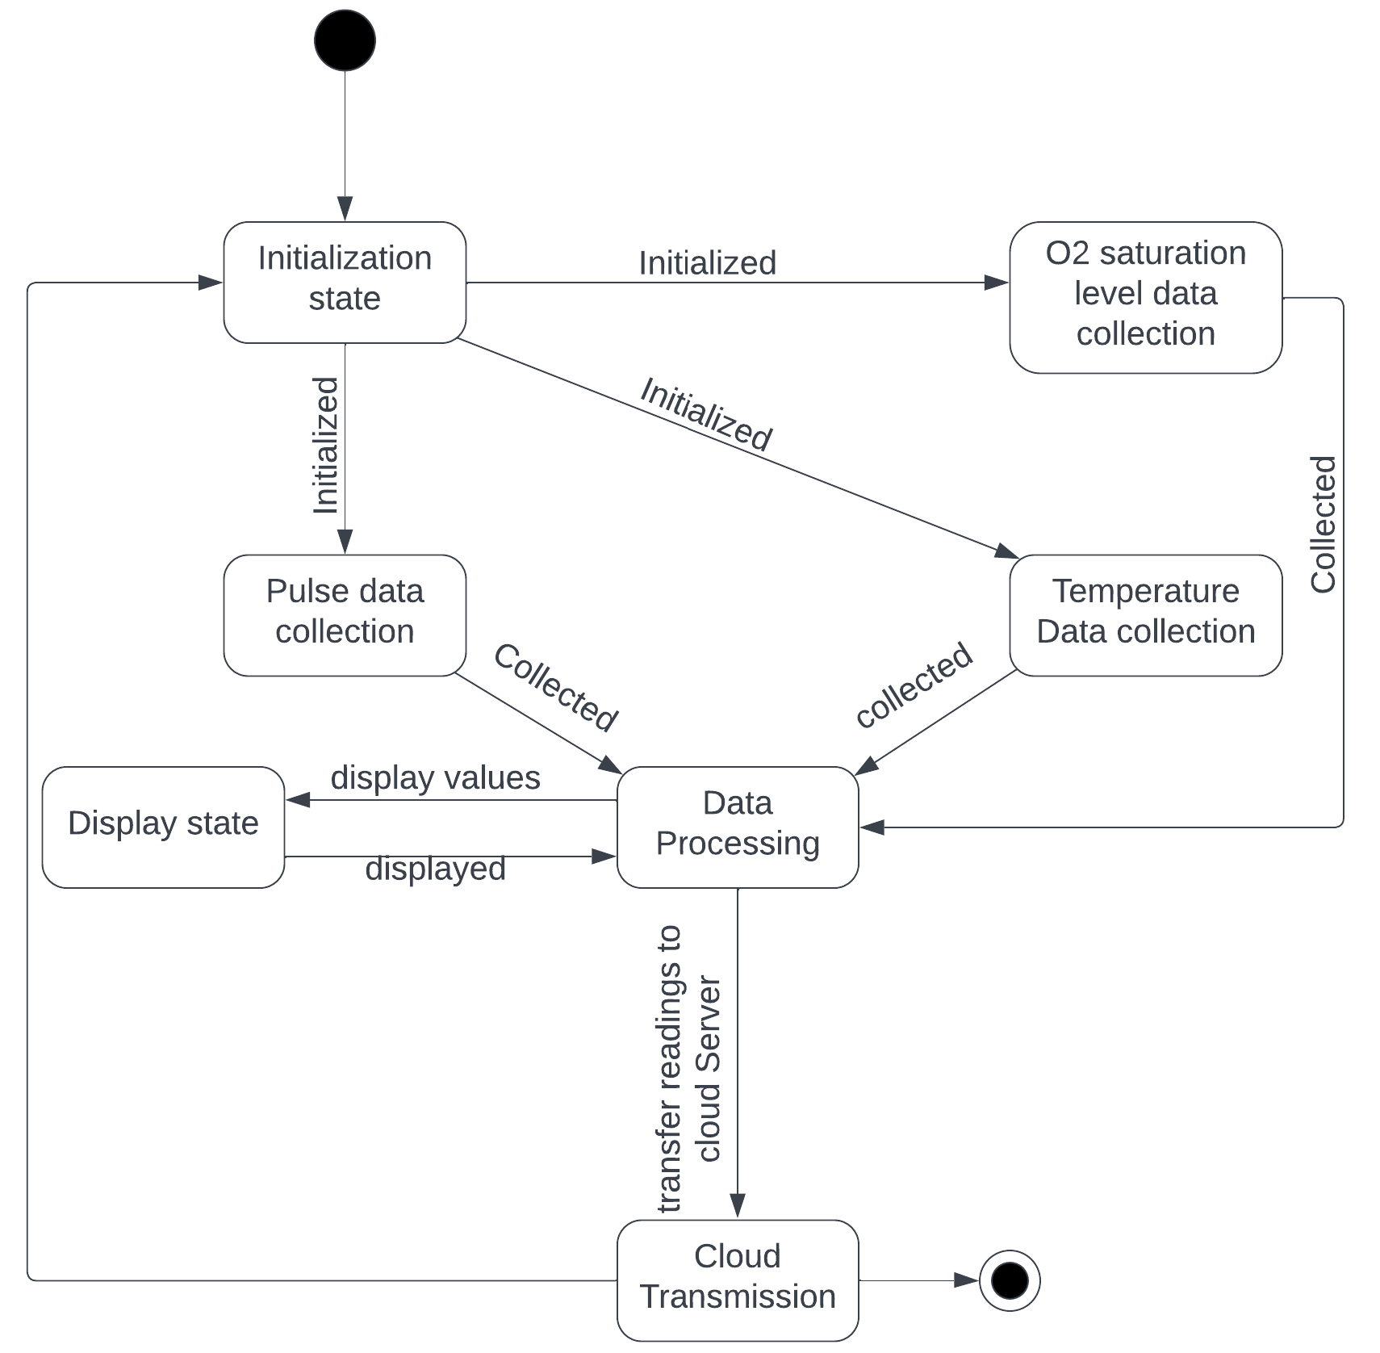
State Machine Diagram

Slide 7
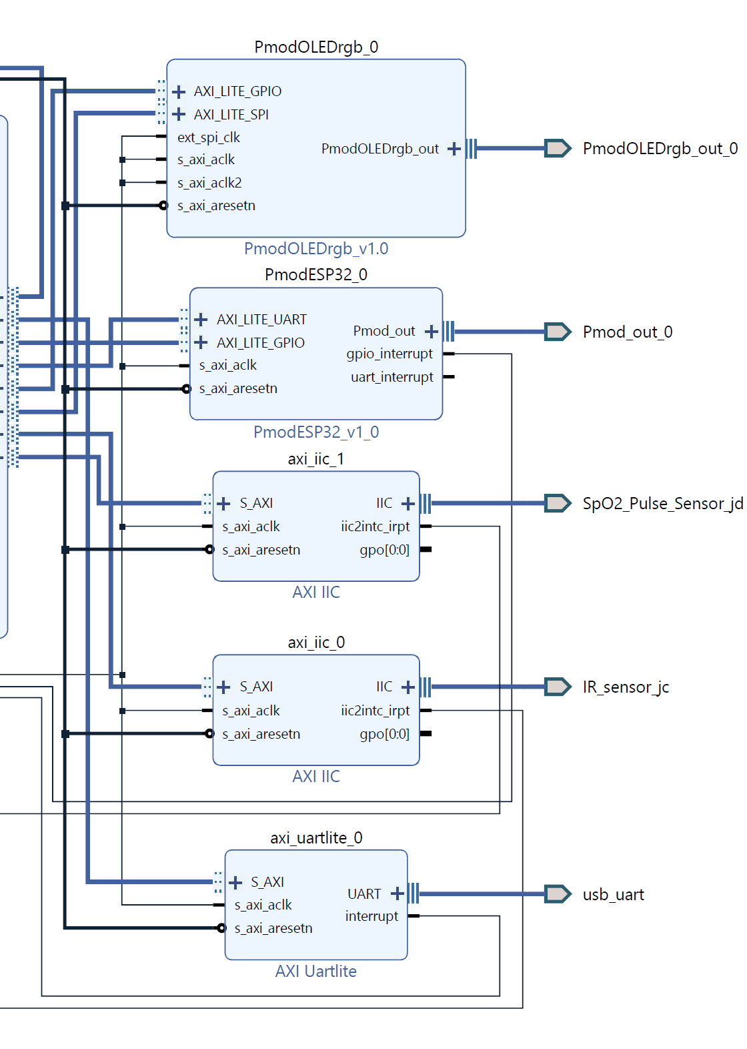
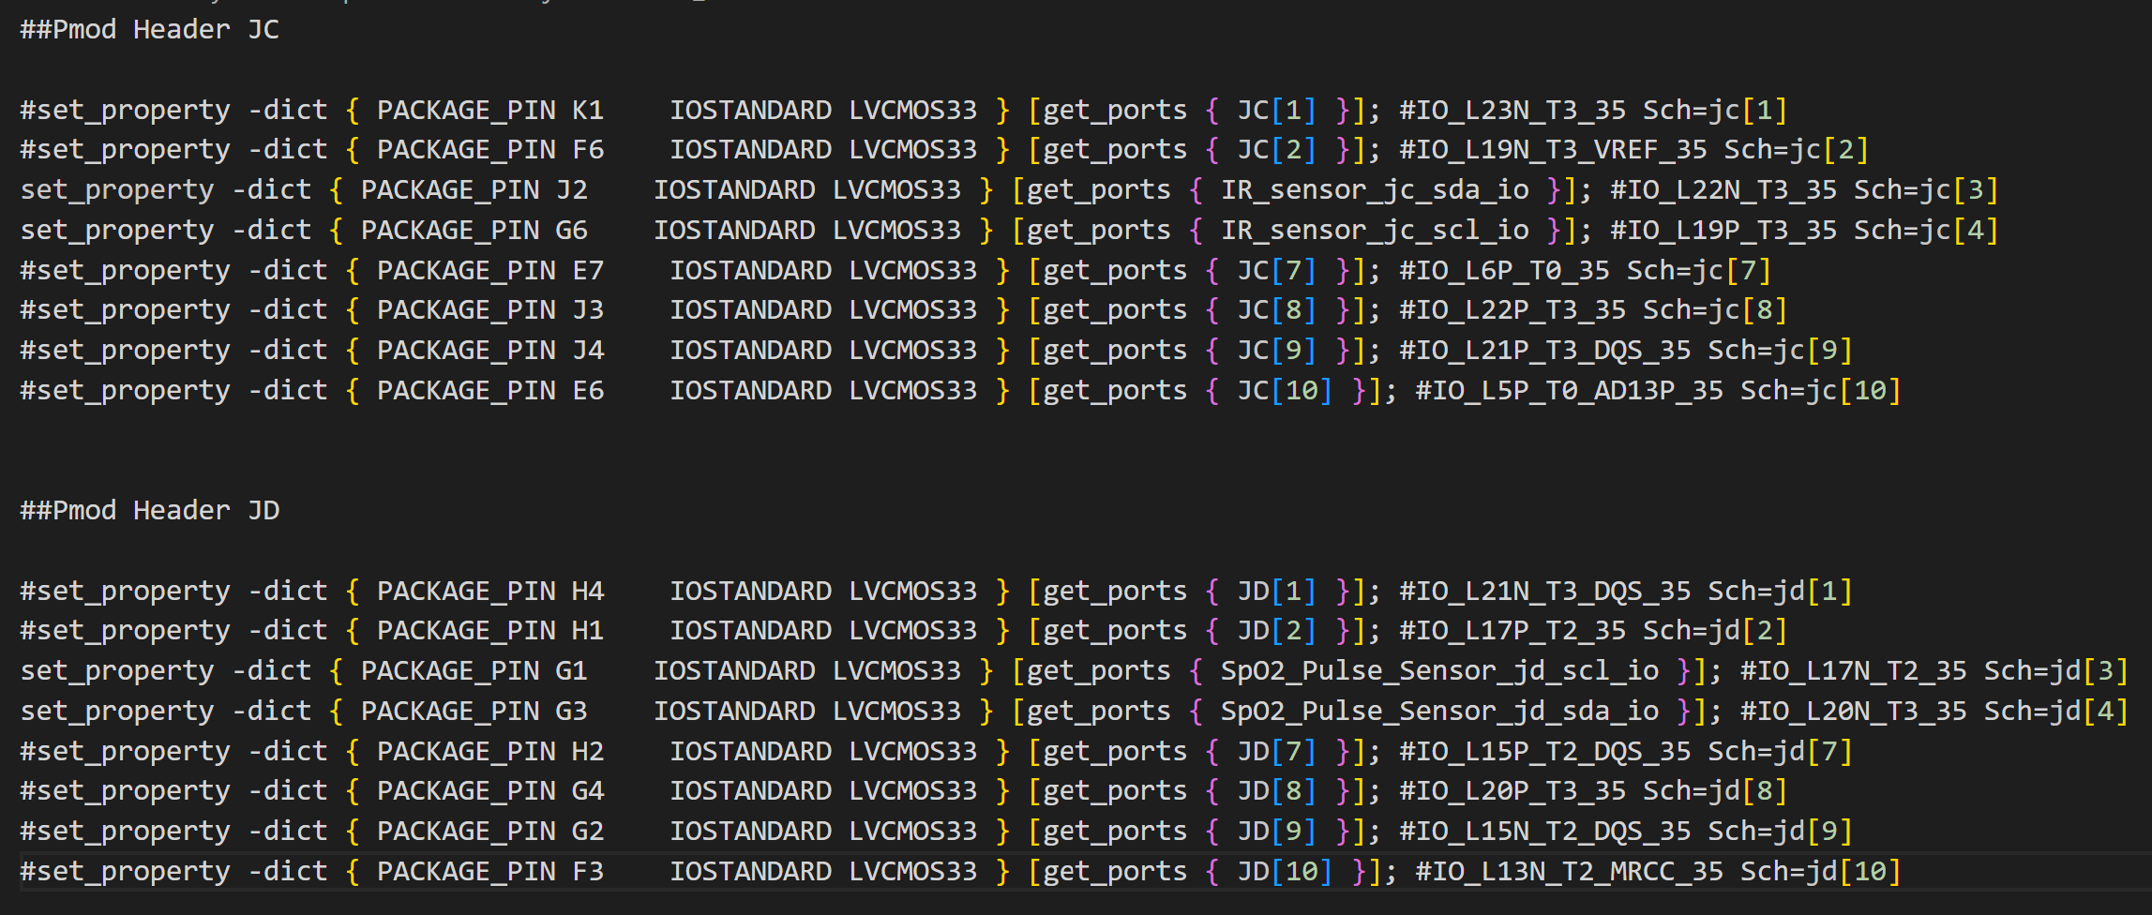
Hardware Implementation

Slide 8
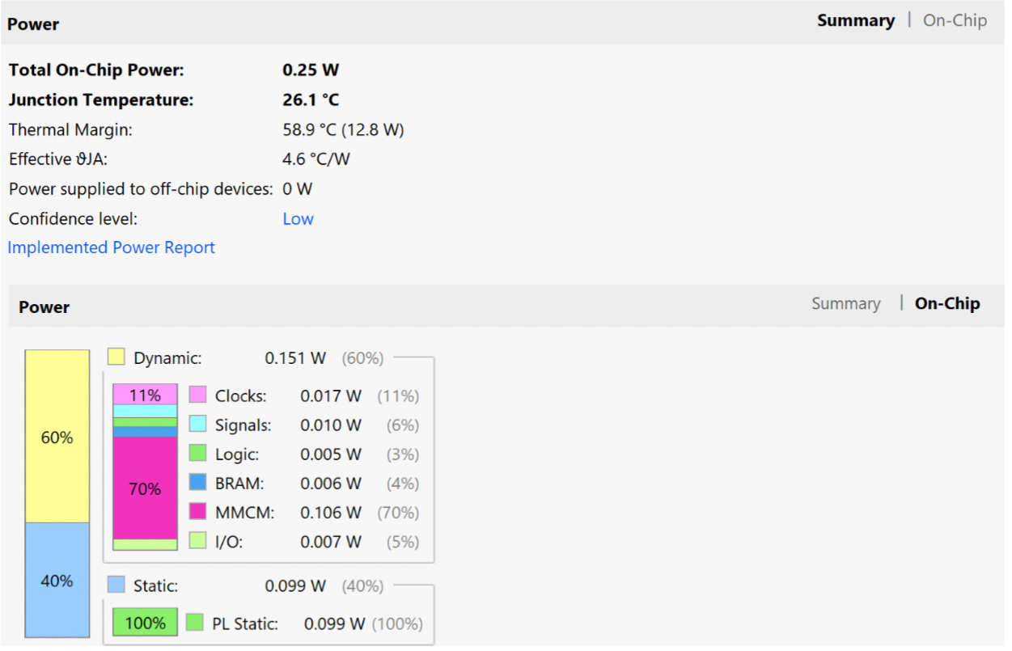
Hardware Design Result

Slide 9
Software
For MLX90614 -->
* Read 0x07 register address of the sensor
* ((( temp_data [1]) <<8 | temp_data [0]) * 0.02) - 273.15 => °C
For MAX30102 -->
* Set up the sensor configuration
* Determine how many samples available on FIFO write pointer address
* read that sample and keep in an array
* wait and repeat it until array size is 100
* From Algorithm.h , call maxim_heart_rate_and_oxygen_saturation( )
And Calculate Pulse and oxygen saturation.
* check if the reading is valid :
1. if not valid : display error in Display
2. If valid , display the data and transmit this data to
Thingspeak for remote visualization including
temperature data .
Wifi Connection : Use AT commands

Slide 10
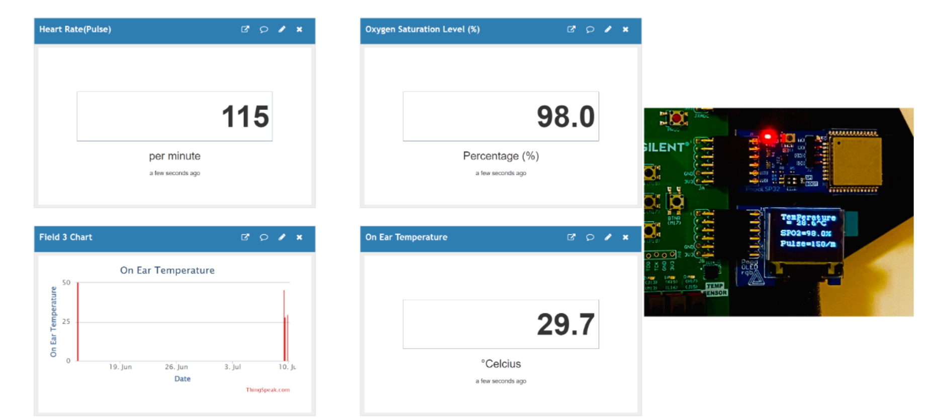
Out Come

Slide 11
Conclusion
The Project was successful though there is some limitation remained
A lot can be done on this project to improve (i.e. error handling , integrating A.I .)
This project lead to a more simple , user friendly multi parameter health monitoring system (remote or local) which is more scale-able and customizable.

Slide 12
Limitations
Memory Problem
* Update data function was
Skipped to address this issue
* Some error handling
Mechanism was skipped
to address this issue
Signal noise issue , resulting inconsistent Oxygen saturation and Pulse reading
Suggestion to improve
Add external Memory.
Design an appropriate device to address signal noise issue
Design an earpods like device:
* Temperature can be
Taken from the ear .
* Also, the earpods can
Be connected with
The Pulse Oximeter
by Bluetooth .

Slide 13
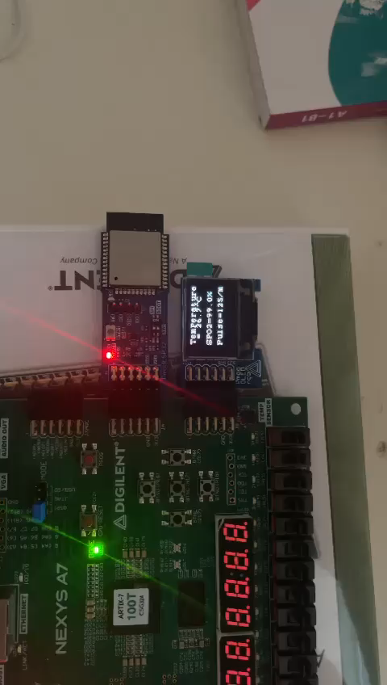

Slide 14


Any Question?
(1) https://www.presentermedia.com/powerpoint-clipart/minion-with-thank-you-sign-pid-24866
(2) https://www.collidu.com/presentation-thank-you-slides

